Slide 1

SIFT Feature Matching for
Counterfeit Currency Detection
DSA0205-Computer Vision with Open CV
Guided By
Dr. Narenthira Kumar A
Name: A. Yaswanth
Reg. No: 192324179
Artificial Intelligence and Data Science

Slide 2
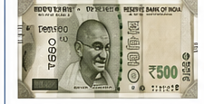
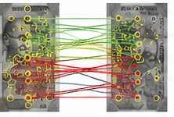

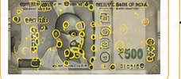








System Architecture
1. Input Acquisition
2. Preprocessing
3. SIFT Feature Extraction
4. Feature Matching
5. Decision Module
6. Output
Capture / Upload
Currency Image
Grayscale Conversion
Scale-Invariant Feature
Transform (SIFT)
Match Query Descriptors
with Reference Descriptors
(FLANN / BFMatcher)
Compute Similarity Score
(No. of Good Matches)
AUTHENTIC
(Real Currency)
Keypoints Detection
(Scale Space Extrema)
Resize
(Normalization)
Score ≥
Threshold ?
Yes
Denoising
(Gaussian Blur)
Query Image
Features
Reference Image
Features
COUNTERFEIT
(Fake Currency)
Camera / Scanner / Mobile
Keypoint Description
(128-D Feature Vector)
No
Contrast Enhancement
(CLAHE)
........
Apply Lowe's Ratio Test
(0.7 – 0.8)
Reference Database (Genuine Currency Images)
Performance & Logging
Update / Add
New Genuine
Images
• Match Score
...
...
...
• Processing Time
• Decision Result
Database
• Image Log
• Store in Database
Precomputed SIFT Features
Key Features
Legend (Flow)
• Scale, Rotation & Illumination Invariant
• Robust to Noise and Viewpoint Changes
Input
Preprocessing
Feature
Extraction
Feature
Matching
Decision
Output
• High Distinctiveness for Currency Patterns
• Real-time Detection Capability

Slide 3
Abstract
Counterfeit currency detection is an important application of image processing and computer vision for identifying fake banknotes accurately and efficiently. This system uses Scale-Invariant Feature Transform (SIFT) to detect and describe distinctive features present on a currency note. The input currency image is first pre processed by converting it to grayscale and improving its quality. SIFT is then used to extract key points and feature descriptors from the input image. These features are compared with the features of a genuine currency reference image using feature matching techniques such as BFMatcher or FLANN. The number of reliable feature matches is analyzed using a similarity threshold to determine whether the currency is authentic or counterfeit. Since SIFT features are relatively robust to changes in scale, rotation, and illumination, the proposed approach can provide reliable matching under different image conditions. The system demonstrates how feature-based image processing can be applied to automated currency verification.

